Slide 1

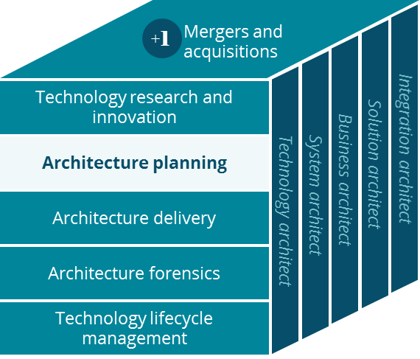
PBM - Coram ® Business Canvas
Architecture Planning

Slide 2
Coram® Infusion Services - Business Canvas
Holistic view of the current Coram® business model
Key Partnerships
Key Activities
Value Proposition
Customer Relationships
Customer Segment
Hospitals
Suppliers
Manufacturers
Rx Fulfillment
Infusion Therapies
In Home
Infusion Services
Face to Face
Digital
Clients & Patients
Patients
Prescribers
Communication Vendors
Patient Care
Nutrition Services
In Home
Enteral Services
Phone
Shippers
& Couriers
Banks
Field Case Management
Payor & Member Billing
Ambulatory Infusion Suites
Medical Claims Processor
Relay Health
Referrals
Logistics
Channels
McKesson (Enteral Disp)
Key Resources
Phone
Pharmacists & Pharmacy Techs
Registered Nurses
Fax
Customer Service Reps
Dieticians
Cost Structure
Revenue Streams
Registered Nurses
Inventory
Insurer Pay
Co-Pay
Pharmacists & Pharmacy Techs
Compliance & Regulatory
Dieticians
Facilities
Includes: Coram

